Slide 1


DX
MATRAS
ACTIVITY
TEAM 4
Management Training System
Alvany
Maulana
Ahmad
Abdurrahman
“Optimizing Training System for
Human Performance
by Digitalization system”
Ahmad Abdurrahman : DM2260924
Alvany maulana : DM2260925

Slide 2


























A Smart Transformation in
Management Training System
when one process =
5 minutes
HRD
Excel
Ms.Form
DOJO PARTICIPANT
Get data from ms Form ➔ Copy to Excel ➔ Edit
WOT
Transfer participant data by WA Group
10 process worked by input manually
CURRENT CONDITION
There are
DOJO
TRAINING
Efficient and Effective Management Training
There are participants who double the training.
so it wastes time
- Way Of Thinking
Total Process Need times for
... Minutes
GOALS
The data input process is still manual so it is not effective
Minimum man hour with effective work and accuracy data.
There is a repeat of sending participant data through to
HR ➔ Muda process
1. Dojo ➔ Result score to HRD
There is no MEIRUKA About Summary data
2. HRD ➔ Data MCU to Dojo
3. Dojo ➔ Distribution Data to HRD
PURPOSE
1
3
4
TARGET
TIMELINE
Create participant imports that can detect duplicate participants
Create a bank participant so that people who pass automatically enter
Export Table by excel
1
0 duplicate participants who join the training
10-14 july 2023
31-2 august 2023
2
5
2
Efficiency process of Inputting Data
Prepare
Development
Trial
Presentation
Make import scores per subject so that it is efficient
Added HR features that can monitor the results of the dojo
3
Efficiency work time for 10 minutes
4
Eliminate Muda process Between HR and Dojo
16-27 july 2023
4 august 2023

Slide 3









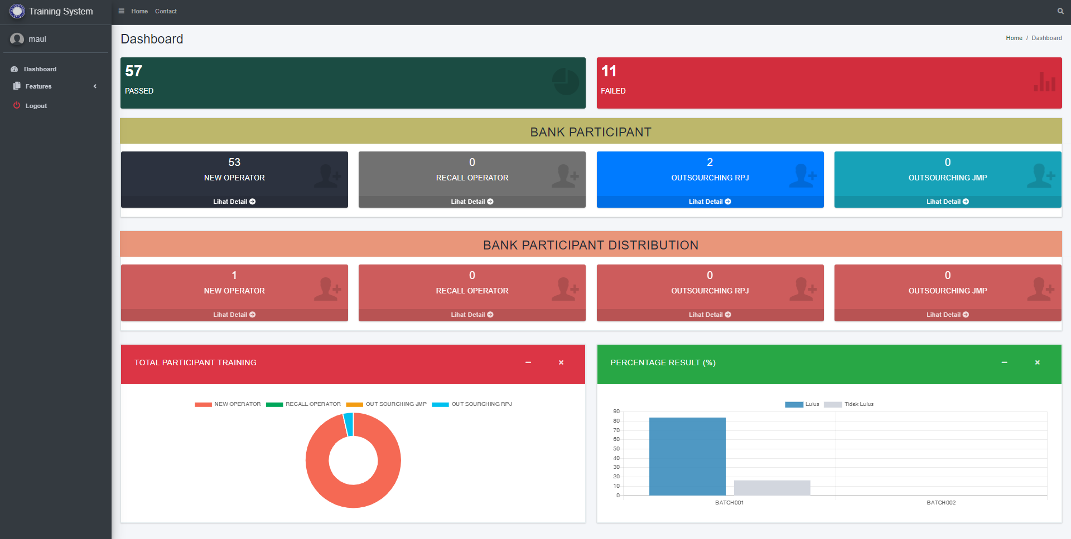
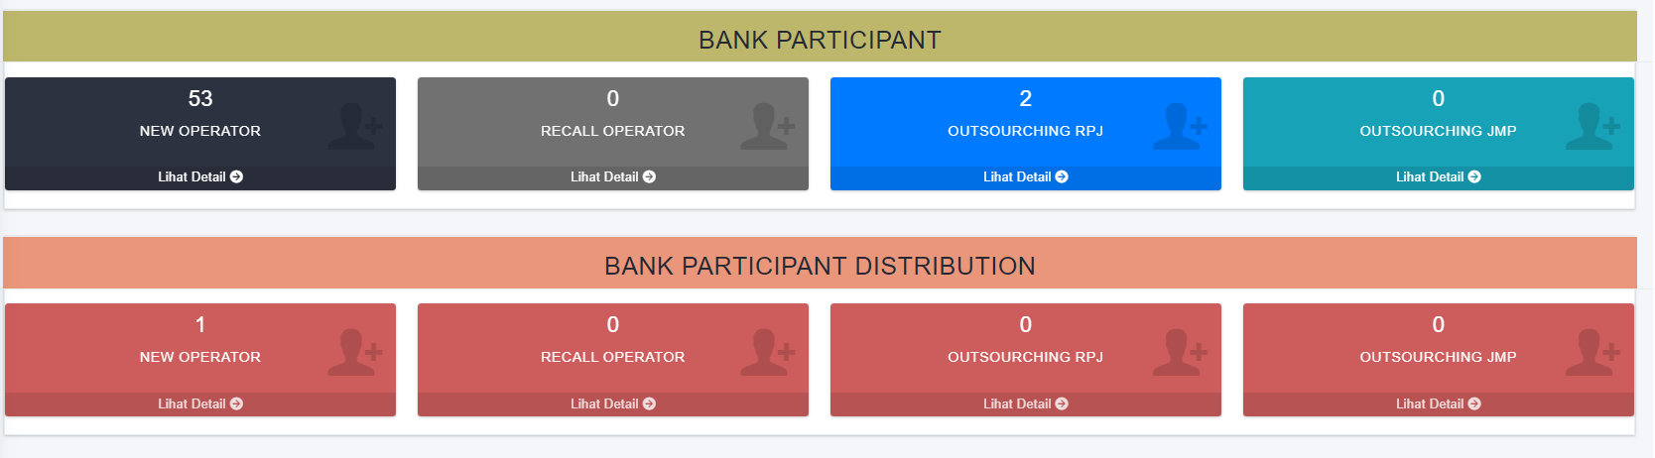
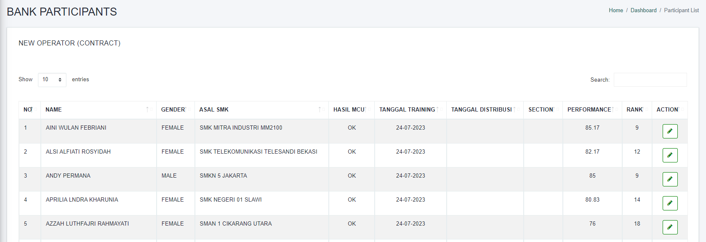


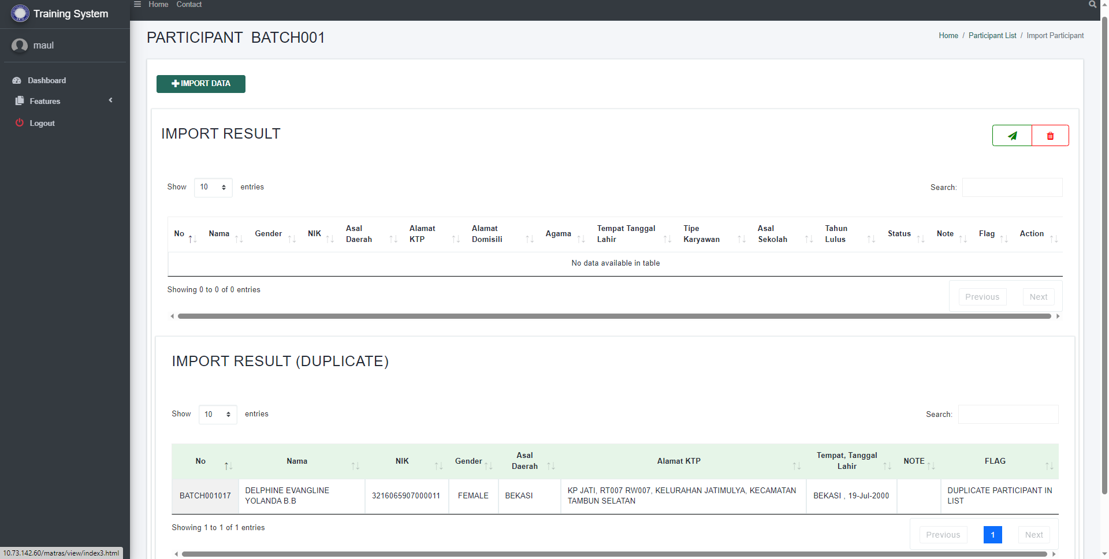
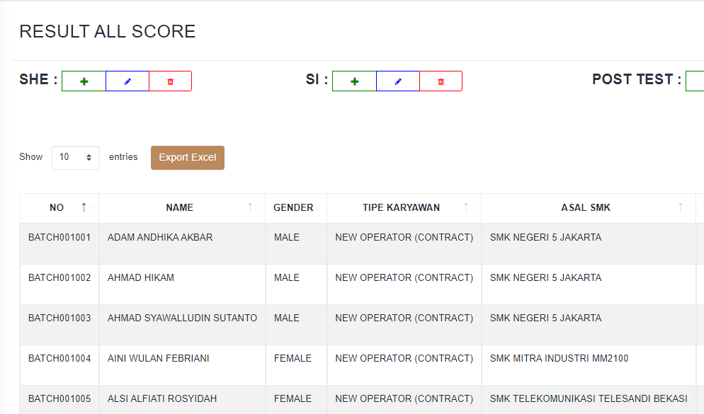





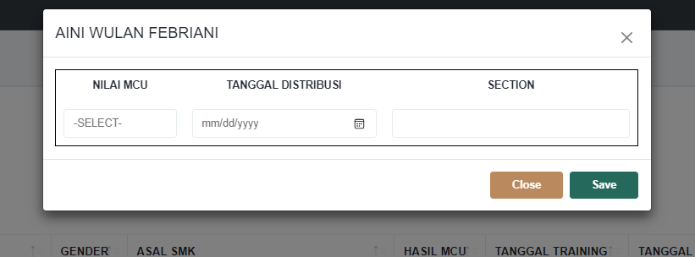
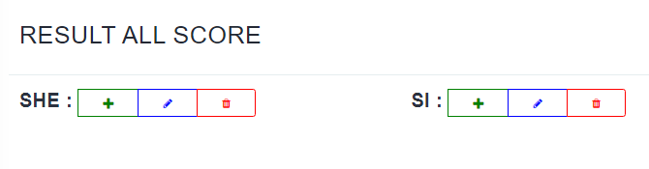
DETAIL SYSTEM
Before Improve
VS
After Improve
Import Score
Matching score
from Microsoft form
Old Flow
DOJO
HRD
Excel
Copy
Form
Collect personal data by Microsoft form and edit in excel manually
Conduct MCU tests on participant who pass. And give the results to Dojo by Microsoft teams
Paste
1 X Import File to Web
Start Training
02
After Training
04
Copy from Excel
There is bank participant in Dashboard
START
Day 1 – Day 5
Before Distribution
BANK PARTICIPANT
01
03
HRD
DOJO
DOJO
Notifies to Dojo there is new participant who will be training by WhatsApp
Manage All Score (Copy, Paste, Edit) in Microsoft Excel And give the summary score to HRD by Email.
Combine Result MCU Tests and summary score then input to bank participant file manually (Copy, Paste, and Sort by rank )
Transfer Data
Monitoring Directly
Dojo
HRD
Dojo
Web System
HRD
New Flow
Struggling Point
DOJO
HRD
Import Score
Collect personal data by Microsoft form and import to web
Conduct MCU tests on participant who pass. And Edit by web if participant failed.
Matching score
from Microsoft form
Features
01
Start Training
02
After Training
04
Bank Participant
Dashboard as MEIRUKA
Bank participant automatically
START
Day 1 – Day 5
Before Distribution
01
03
02
Send All Data to database participant’s Bank
HRD
DOJO
DOJO
Notifies to Dojo there is new participant who will be training by WhatsApp
Import All Score from Microsoft Excel to Web, And HRD can monitoring the result directly.
All Participants who pass directly enter the participant’s bank.
User Needs
Import Detect participant retraining
03
Qualifying user needs with Our capability
Export to excel
Visualization
Pair Programming
Visualize Dashboard
04
Visual Studio Code
Database
Web Server
HR Feature
Import score each subject

Slide 4











IMPLEMENTATION
ACTUAL BENEFIT
TARGET
IMPLEMENTATION
1
2
REDUCE MAN HOUR ?% AND EFFICIENT WORK
Time
Time
Time
Time
Time
MANUAL
INPUT
Input personal data
Copy Paste
Sport Score and each Subject Score
Input Participant Passed to Bank Participant
Send Summary Score to HR by E-Mail
Update MCU result From HR
Import Data
by Excel
Meiruka
In Dojo Training
INPUT BY
WEBSITE
Import Personal Data
Import Daily Sport score and Subject score
Send to Bank Participant
Export Summary score by HR
Update
MCU result by HR
3
4
Time
Time
Time
Time
Time
100Mh
ACTUAL
REDUCE
MAN HOUR
100Mh
REDUCE
100%
MAN HOUR
EFFICIENCY WORK
Input data
direcly
HR Monitoring
By HR Fitur

Slide 5







LEARNING POINT
Communication
How to communication
with user for project
Next nya fiturnya juga menunjang semua bukan hanya reduce man hour tapi juga man power, cost material, muda proses, dan hal hal yang menunjang lainya
Concept
Export to Excel
How to Create concept correctly
Export table website to Excel
New Understanding
Import Fitur
Bank Participants
New fitur import each subject
Manage Participants Passed
Send to Database
Input data to Database from table HTML

Slide 6


